Slide 1



STUDENT PORTAL
MANAGEMENT SYSTEM
Presented by:
MD. Tushar Khan
MD. Minhaz Ahamed Rohan
MD. Ashike Rabby

Slide 2

OVERVIEW
01
02
03
Introduction
Objectives
System Features
04
05
06
Implementation Plan and Outcomes
Expected Outcomes
Conclusion

Slide 3




INTRODUCTION
The Student Portal Management System is a comprehensive platform designed to streamline student data management, academic records, and login functionalities.
This system will integrate a Graphical User interface (GUI) for easy access, a calculator to generate cumulative grade point averages (CGPA), and an Excel-based database for data storage. The portal aims to enhance accessibility, efficiency, and accuracy in student record management.
The entire system will be developed using C++, ensuring high performance, robustness, and efficient memory management.

Slide 4

KEY FUNCTIONALITY
Student Info
Login Panel
CGPA calculator
Data Storage
GUI

Slide 5





PROBLEM STATEMENT
01
Challenges of traditional student record management
02
Security Concerns
03
Manual errors, Inefficiencies
04
Need for an automated system

Slide 6





OBJECTIVES & SYSTEM FEATURES
Student Information Record Management
Excel-based data storage
Secure Login Panel
Automated CGPA calculator
GUI for user-friendly access

Slide 7



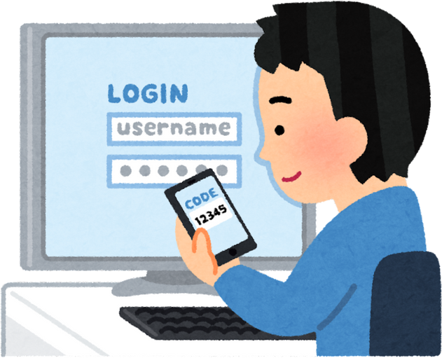


TECHNOLOGY STACK
Programming Language: C++ (OOP principles, STL for data handling)
GUI Framework:
Qt for cross-platform GUI development
Authentication: Secure hashing techniques
Database: CSV/Excel file integration

Slide 8

IMPLEMENTATION PLAN
Phase 1:
System Design & Requirement Analysis
Phase 2:
Development
Phase 3:
Testing & Debugging
Phase 4:
Deployment & Maintenance

Slide 9



EXPECTED OUTCOMES
• Centralized student data management
• Secure authentication system
• Fully functional CGPA calculator
• Excel-based record-keeping
• High-performance, scalable system in C++

Slide 10


Thank's For Watching!!

